Slide 1
Fragrant Community
Wang, Yating
1155160796

Slide 2
Description
Now perfume becomes popular with Chinese young girls and many young girls want to have perfume decorates their life. But a bottle of famous perfume is usually very expensive and unaffordable to those who are students or fresh in society. And it is very hard to determine whether you are suitable to one perfume unless you use it and feel its top note, middle note and base note. So, picking your favorite perfume takes time.
I want to design a community where young girls can share their experience and knowledge about perfume, and most importantly, share their own perfume to others. Thus, those who are worried about how to consumer the rest of their perfume can spread them to other can make a profit and young girls who have not enough money to but a bottle of one can have a try in a reasonable pay.

Slide 3
Interview
I interview five young girls. They are:
Experienced User
Fragrance collector
Low frequency user
Fragrance Freshman
Gift Buyer

Slide 4
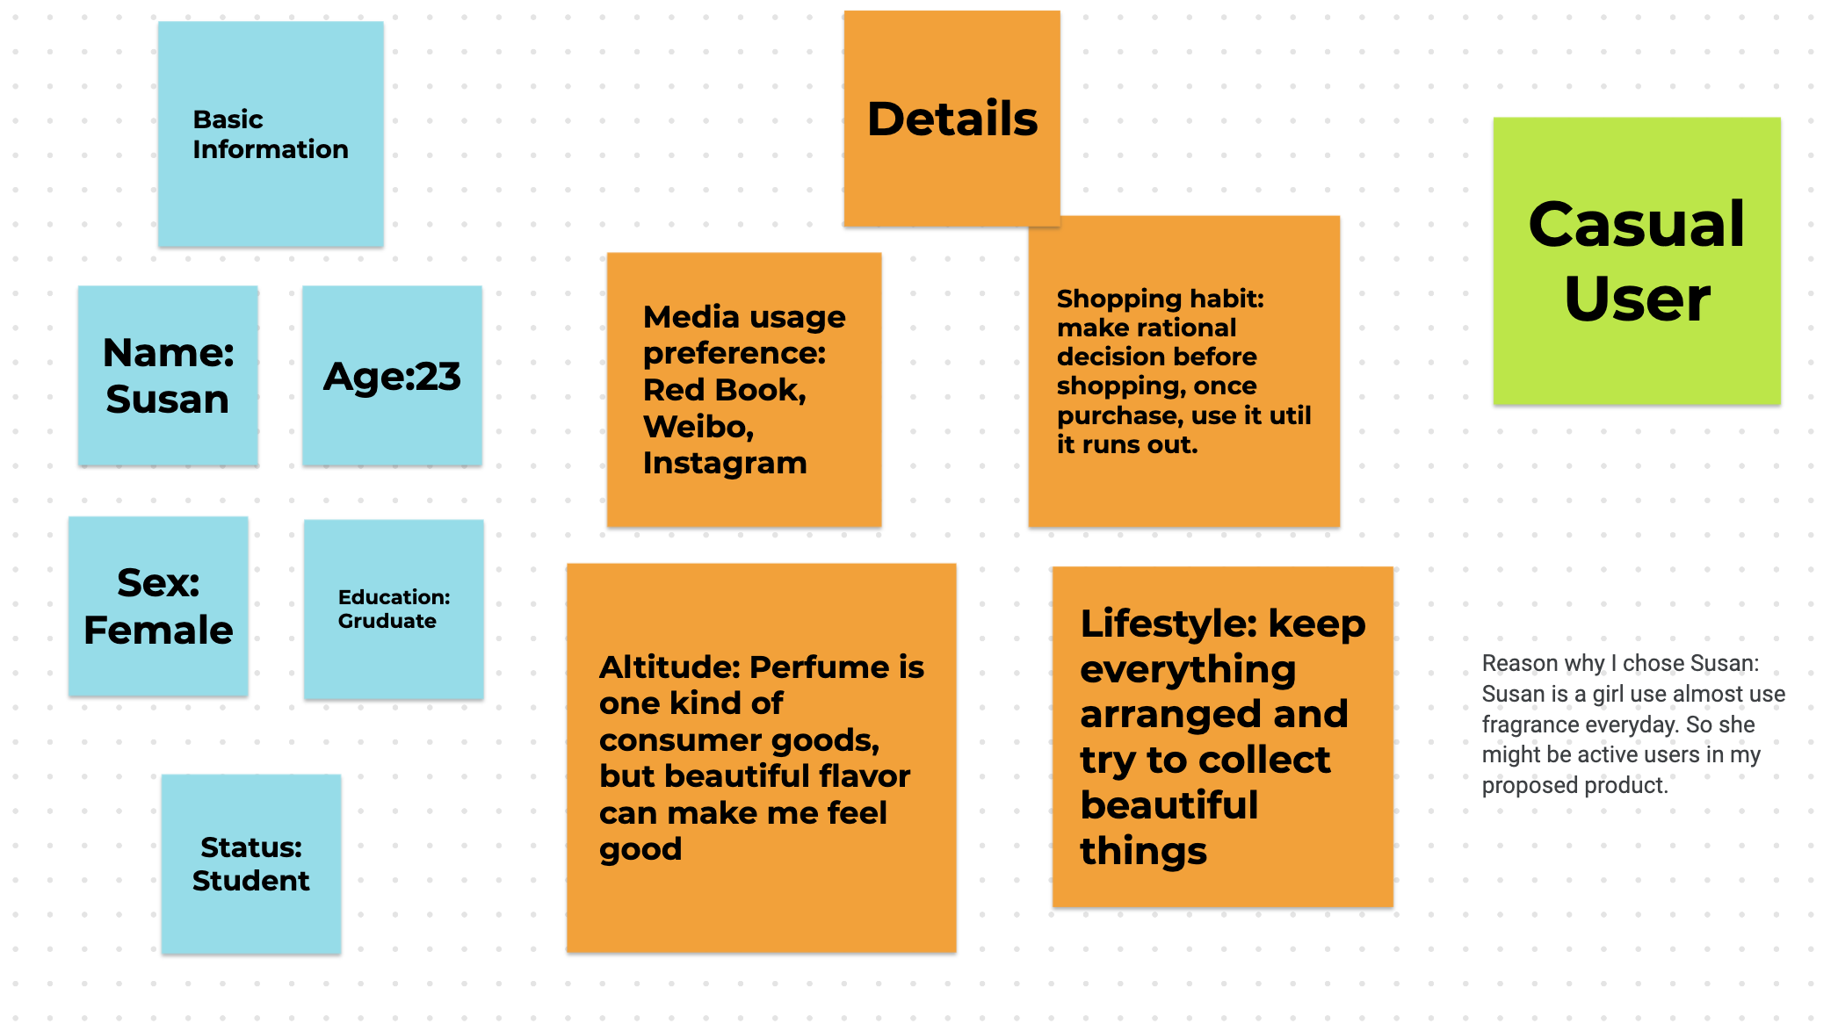
Persona

Slide 5
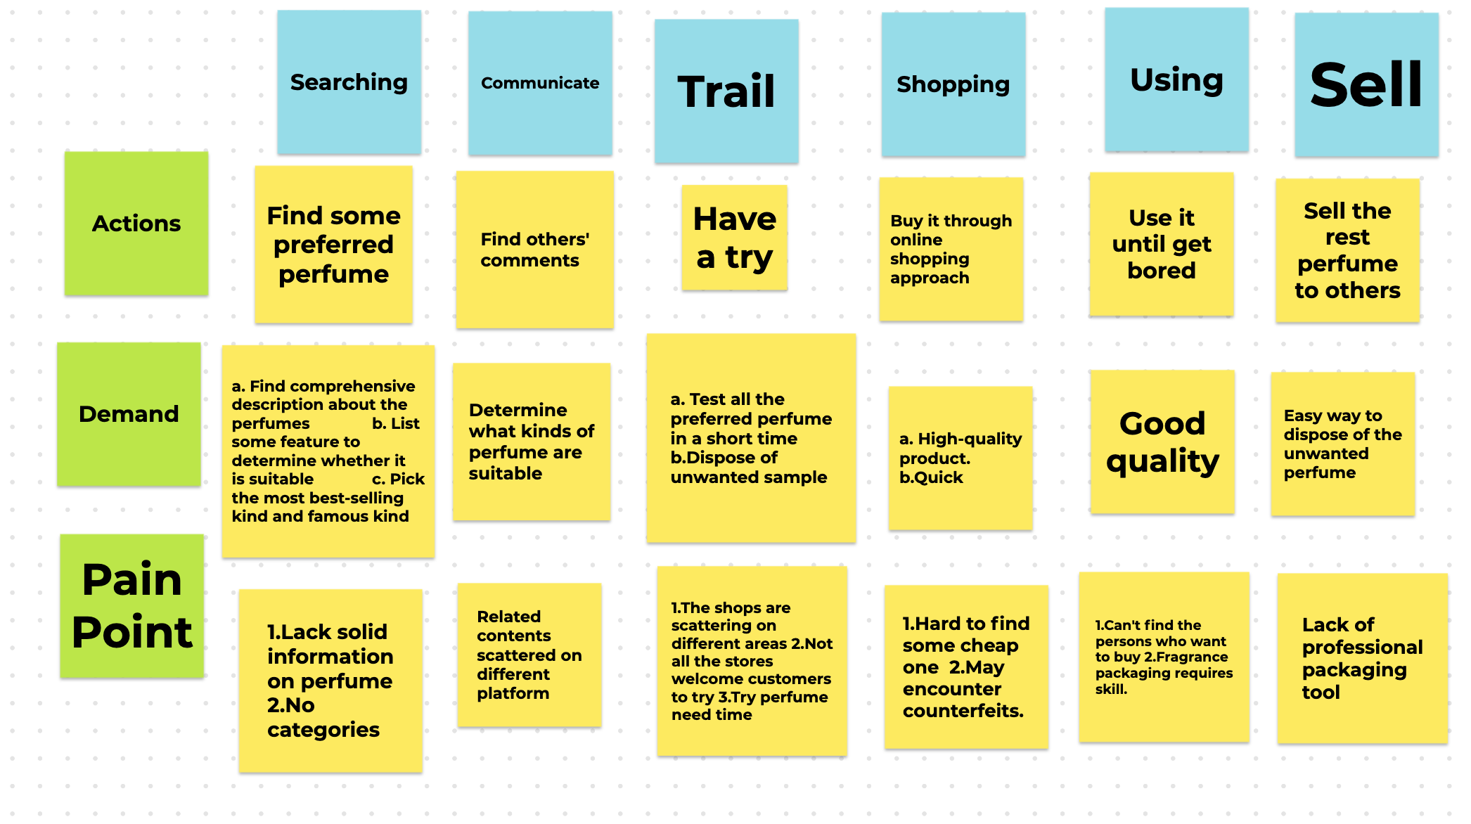
Journey Map

Slide 6
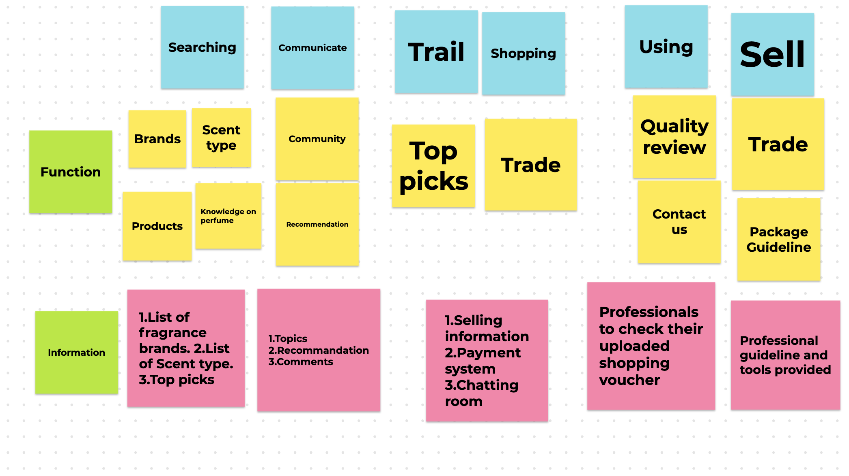
Story Map

Slide 7
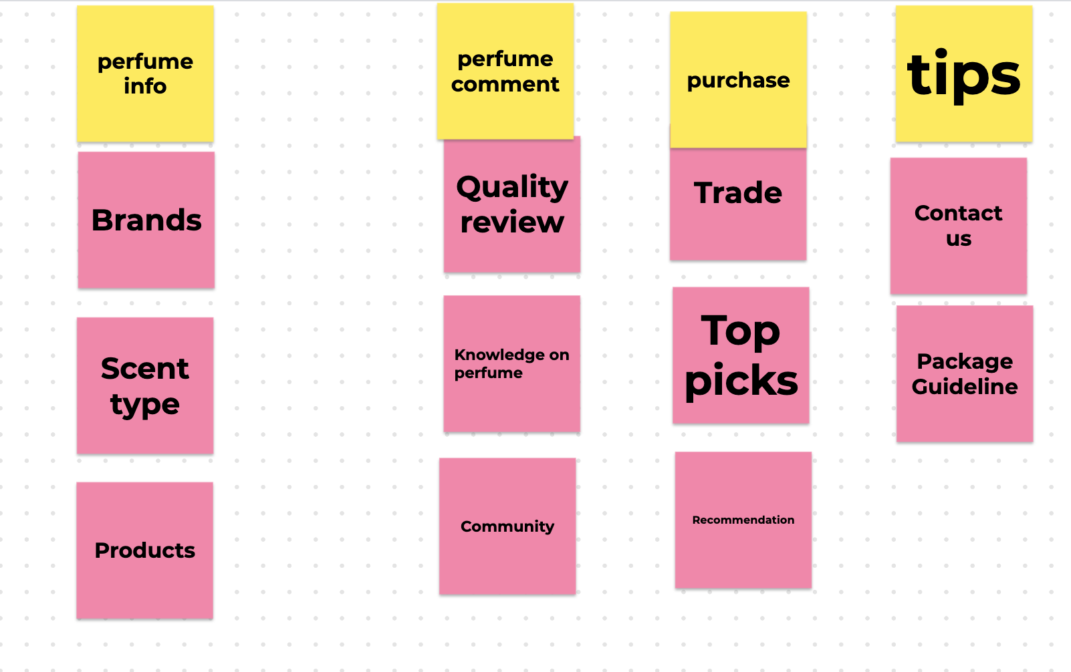
Grouping1

Slide 8
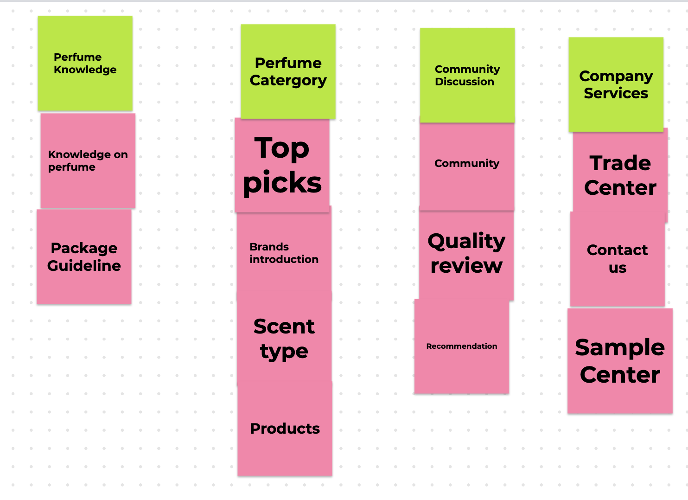
Grouping2

Slide 9
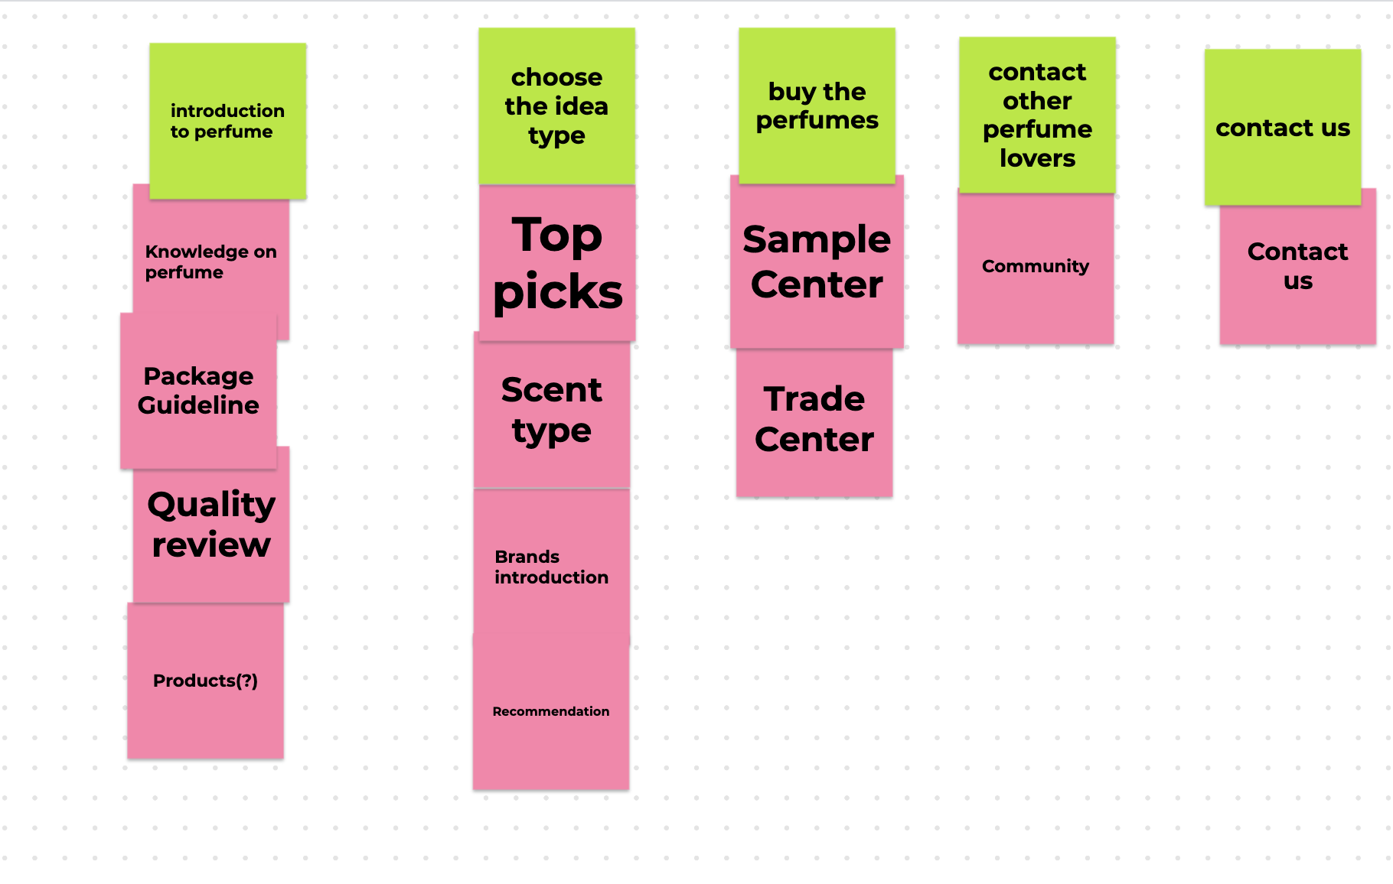
Grouping3

Slide 10





Position Map
Purchase
Target Area
Community

Slide 11
Problem Statement
How might we help young girls who are interested in Fragrance to find a place where they can search and share information and their own fragrance so that these girls can obtain different kinds of perfume in a reasonable price and make a profit through selling their unwanted ones.

